Slide 1

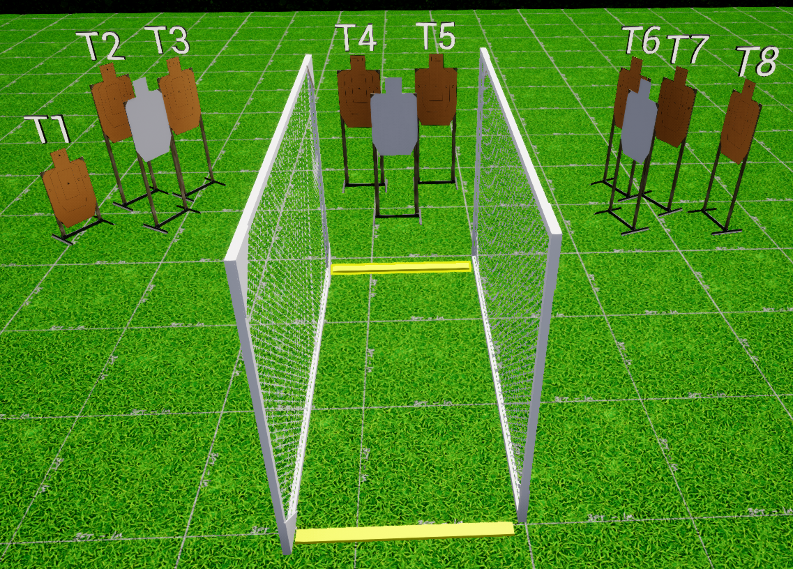
 | Interlake Sporting Association Action Bay, A Stage: Bump In The Night Course Designer: Nathan Jarvis
SCENARIO: You are a 12 year old boy and you’re woken in by a broken window. Your dad can’t get his gunsafe open, but luckily you know the combo to your mum’s so your arm yourself and take care of the problem while your dad continues to struggle.
START POSITION: Heels touching starting fault line. Handgun: Loaded and holstered, wrists below belt. PCC: Stock on belt, muzzle pointed downrange. |  | STRINGS: 1 SCORING: Unlimited ROUND COUNT: 8 START-STOP: Audible - Last shot
STAGE PROCEDURE: At the start signal, engage T4&T5 in the open, then engage all remaining targets from P1. Reload required between first and last shot
P1
Start

